Slide 1
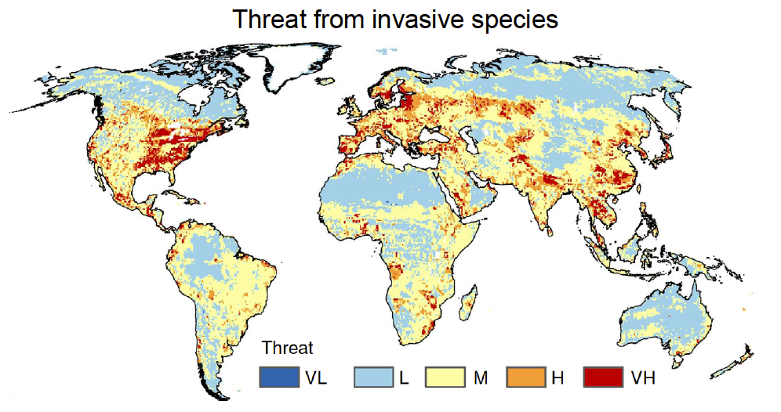
Be AIS AWARE: Mapping AIS Mayhem
Notes:
Presenter Notes: This map characterizes to what extent invasive species would likely be introduced to different countries due to global trade and other similar activities. The areas with “Very High” threat are places with high human populations, greater airport and seaport capacity, as well as, significant international travel, which could be a source of more introductions of invasive species. Ask the students why the Eastern US is more threatened by invasive species. Discuss the ways in which foreign goods are transported to the United States.

Slide 2
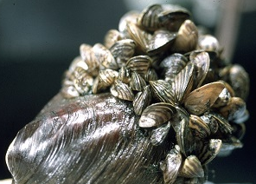
WHERE are zebra and quagga mussels native?
Make a prediction...
Notes:
Presenter Notes: Ask the students to make a prediction on where they think the zebra and quagga mussels originally came from and how they think they got to the U.S. Students may share their ideas verbally.

Slide 3
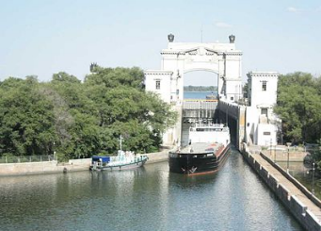
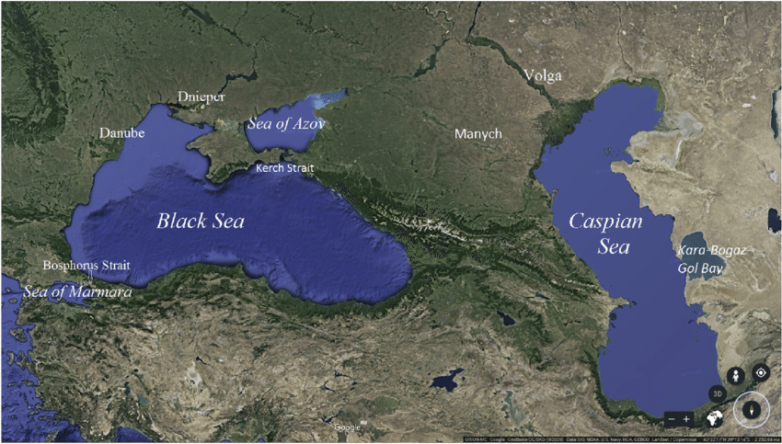
Zebra mussels are native to the
Black, Caspian, and Azov Seas
The Volga-Don Canal connects them
13 locks move the shipping vessels
(89% are WESTWARD)
Notes:
Presenter Notes: Zebra mussels are native to the Caspian, Black, and Azov Seas in Eastern Europe. All three FRESHWATER bodies of water are connected via natural rivers and the Volga-Don Canal. Approximately 89% of cargo shipped from the Caspian Sea is shipped westward. The cargo is then sent all over the world.

Slide 4
Quagga mussels are native to the
Dneiper River
Dnieper River
Notes:
Presenter Notes: The quagga mussels are native to the Dnieper River that flows into the Black Sea.

Slide 5
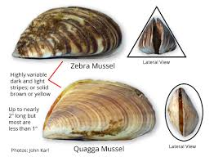
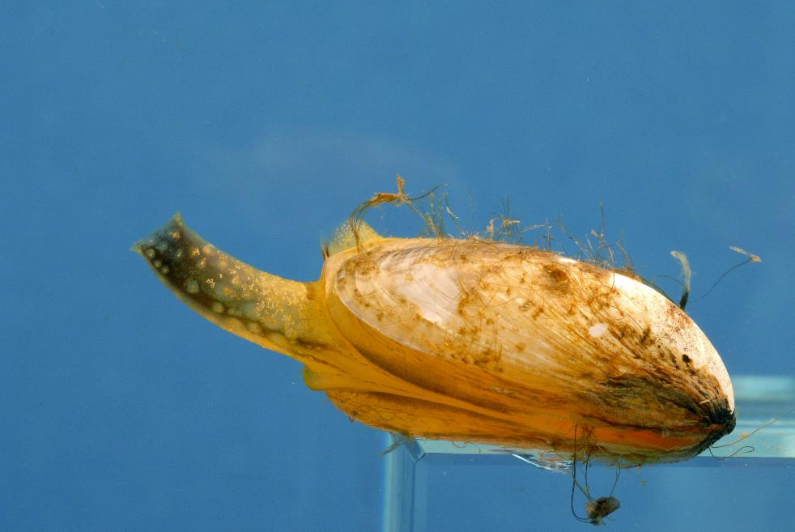
WHAT makes these mussels so invasive?
Water enters the
incurrent siphon
Waste and gametes exit the
excurrent siphon
Byssal threads attach to surfaces
Notes:
Presenter Notes: The zebra and quagga mussel are very similar in size. Both can have stripes with great variation in color. When placed on a table, the triangular quagga shell will sit upright, whereas the rounder quagga shell will fall down. The incurrent siphon brings water into the mussel’s body, the food is filtered out, and then the wastewater is released through the excurrent siphon. Each adult mussel can filter up to 1 liter of water per day. One adult female can release up to 40,000 eggs in one round of reproduction (~1 million eggs/year). The eggs and sperm are released from the excurrent siphon into the surrounding water where they combine. The fertilized eggs grow into larval veligers. These microscopic, planktonic larvae drift with the water currents for up to a month and can be transported great distances.

Slide 6
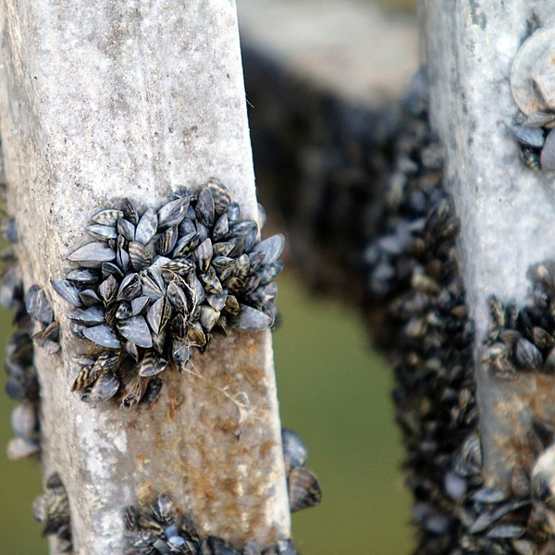
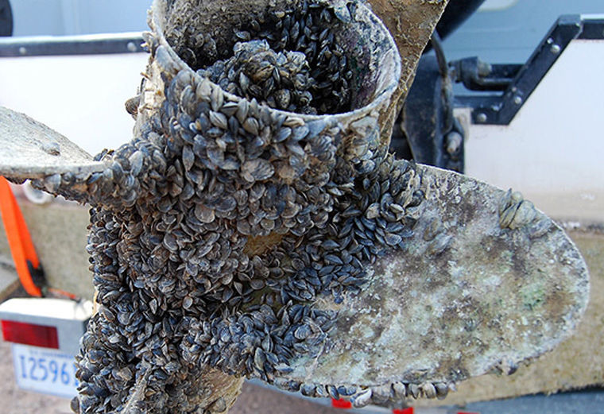
WHAT makes these mussels so invasive?
Notes:
Presenter Notes: Unlike native mussels found in Montana, the adult zebra and quagga mussels attach to surfaces with byssal threads, which allows them to be transported great distances as hitchhikers on man-made objects. They can stay alive outside of water for up to 5 days.
The Dneiper River, Black, Caspian, and Azov Seas are all freshwater locations. Ask the students to share how they think the freshwater mussels were transported across the salty ocean and introduced to the freshwater Great Lakes in the United States.

Slide 7
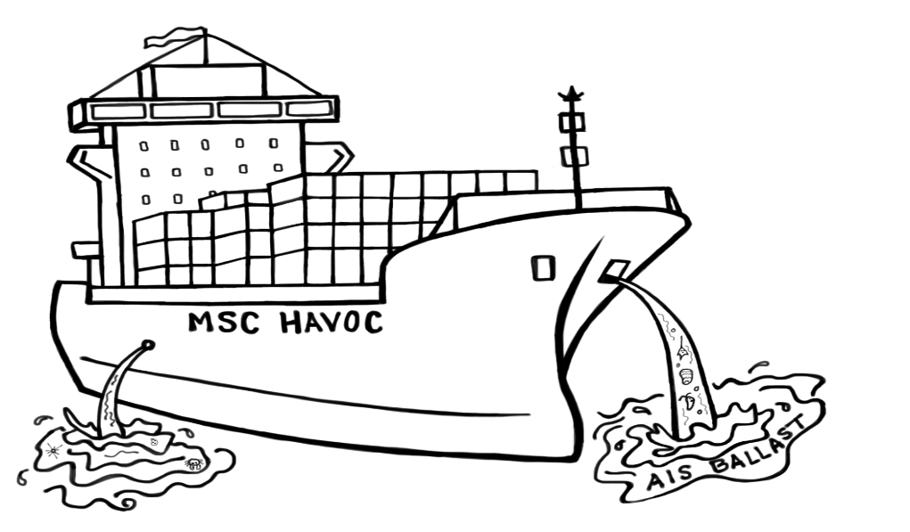
How did the invasive mussels get to the United States?
Cargo ships released contaminated ballast water into the Great Lakes!
Notes:
Presenter Notes: The mussel larvae can get pumped into the ballast tanks of cargo ships and unintentionally transported to new ports. The ships add ballast water to keep them from tipping over when they have less cargo loaded.
Explain to the students that the two sinks in your classroom (or two large bowls) represent the Black Sea and Lake Erie. Explain that the plastic water bottle represents a cargo ship. Walk the empty water bottle (cargo ship) to the “Black Sea” sink/bowl and explain how it would float too high when not loaded with cargo. Fill the “empty ship” with “ballast water” at the port and explain that as the cargo is loaded some water is released at port. Walk the loaded ship across the room to the other sink/bowl and explain as you go that the ship is traveling from the Black Sea to the Mediterranean Sea and eventually out across Atlantic Ocean to the St. Lawrence River (Seaway). The ship will then arrive at the “Lake Erie” sink or bowl and again add ballast water as it unloads the cargo. When the new cargo is loaded at the new port the ballast from the Black Sea is then released into Lake Erie.

Slide 8
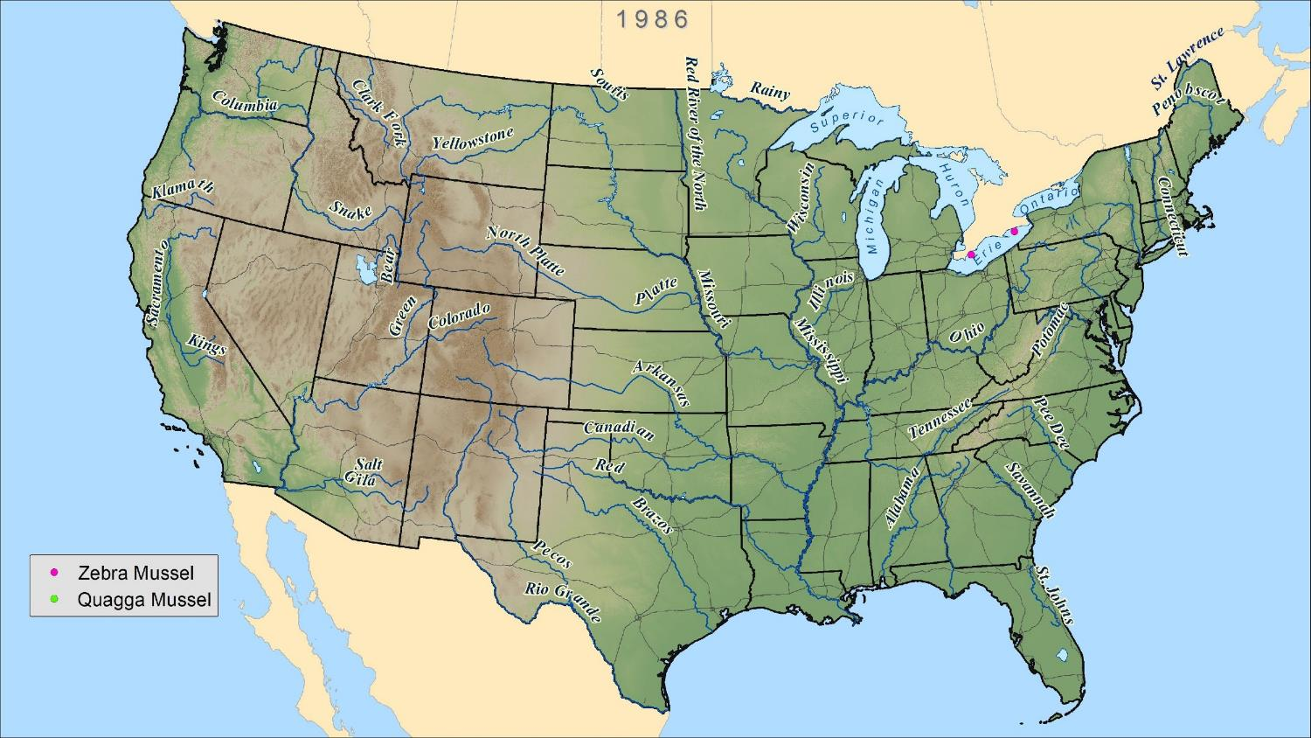
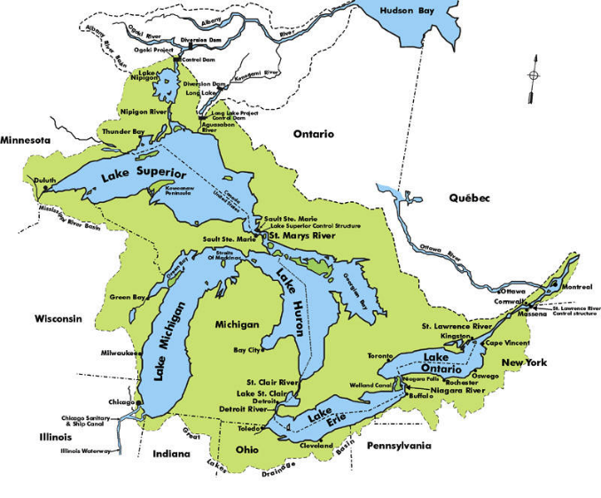
Initial Zebra Mussel Detections
Make a prediction:
Where do you think the zebra mussels spread to first?
Notes:
Presentation Notes: Explain that you will be flipping through mussel distribution maps that display the new mussel detections starting from when the zebra mussels first arrived in the U.S. Identify the map key, and quickly describe how the cargo ships get to the Great Lakes through the St. Lawrence River or through the Erie Canal located along the Hudson River. Review the names of the Great Lakes, and point out that the lakes are all connected. Ask the students to record the year the zebra mussels first arrived on their worksheet (1986) and to make a prediction and record where they think the mussels will spread to first.

Slide 9
Notes:
Presenter Notes: The mussels have stayed in the Lake Erie area.

Slide 10
Notes:
Presenter Notes: The mussels have now spread to Lake Michigan.

Slide 11
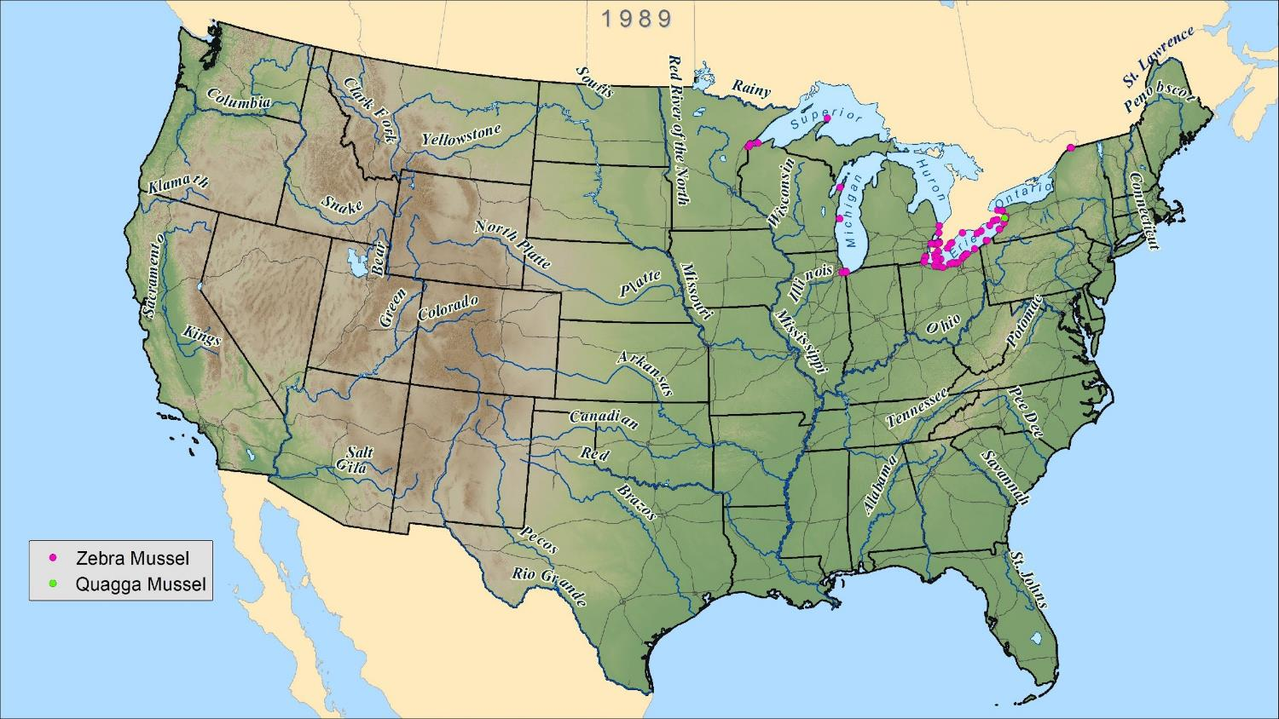
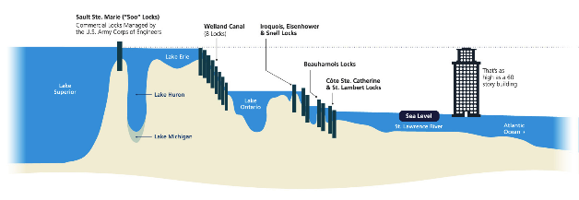
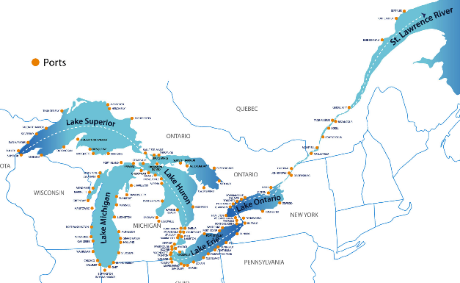
Initial Quagga Mussel Detection
Notes:
Presenter Notes: The mussels have now spread to Lakes Michigan and Superior. Notice many of the new mussel detections occurred near major shipping ports. Approximately 4,000 cargo ships pass through the St. Lawrence Seaway annually. Once the invasive mussels entered Lake Erie, it was very easy for them to be transported to other ports, again through the release of ballast water. Students record that the quagga mussels were first detected in 1989.
Notice the smaller map displays the primary ports found in the Great Lakes.

Slide 12
Where did the invasive mussels actually spread to initially?
Notes:
Presenter Notes: Students record that after just four years, the mussels have spread to ALL FIVE GREAT LAKES.

Slide 13
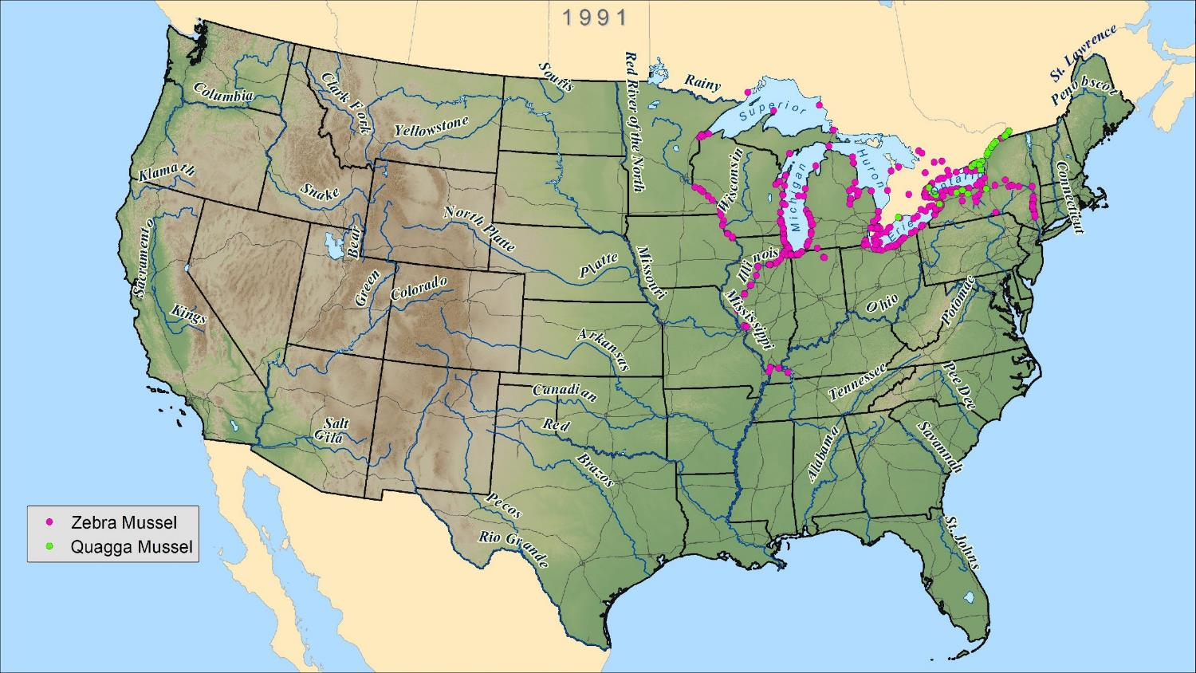
5 years later...
Notes:
Presenter Notes: Five years post introduction: The zebra mussels have spread downstream along the Illinois River and hitchhiked to the Mississippi and Ohio Rivers. The quagga mussels also spread further throughout the Great Lakes.

Slide 14
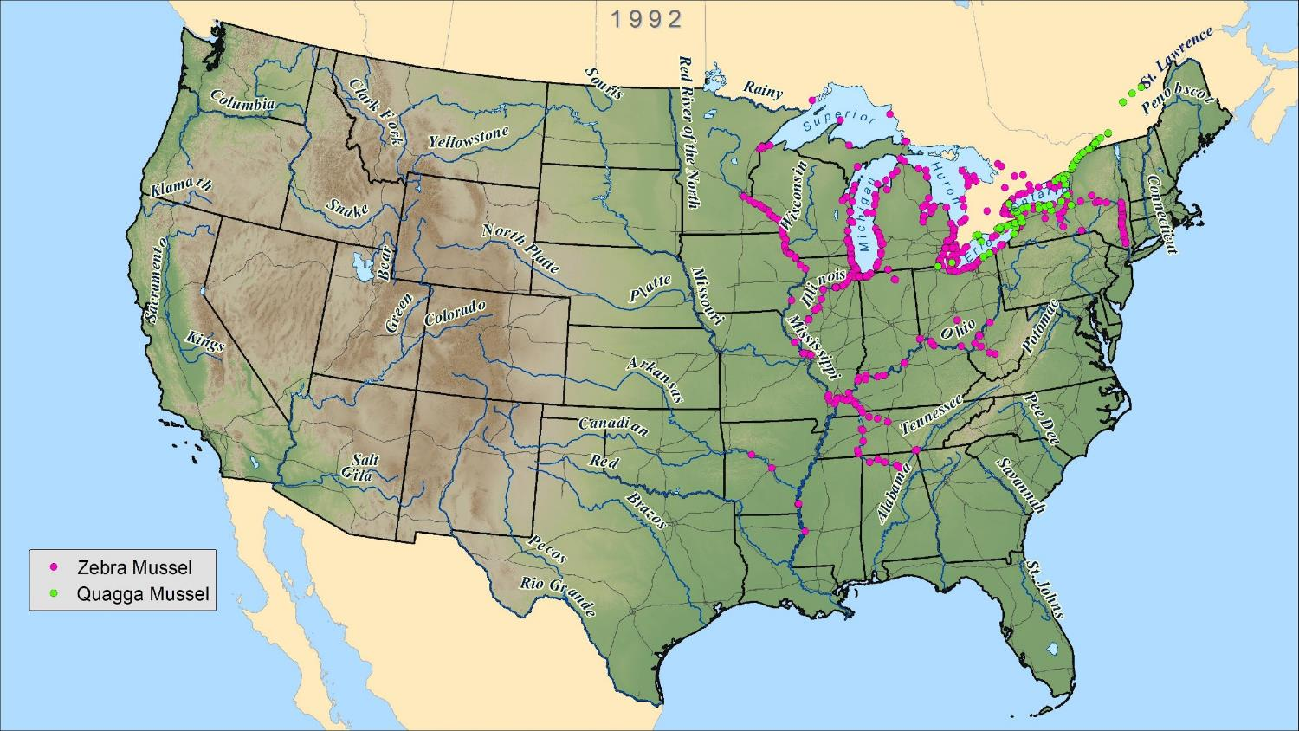
Notes:
Presenter Notes: The zebra mussels have spread downstream along the Mississippi River and hitchhiked to the Arkansas and Tennessee Rivers. The quagga mussels have continued to spread throughout the Great Lakes. Notice the zebra mussels are now throughout the lower Hudson River and Erie Canal in New York (another shipping pathway to the Great Lakes).

Slide 15
Notes:
Presenter Notes: The zebra mussels have continued to spread downstream and throughout the Great Lakes. The quagga mussels have become well established in Lake Erie and Lake Ontario and they have hitchhiked to the Ohio River.

Slide 16
Notes:
Presenter Notes: The zebra mussels have continued to spread downstream and throughout the Great Lakes. The quagga mussels have become well established in Lake Erie and Lake Ontario and they have hitchhiked to the Ohio River.

Slide 17
Notes:
Presenter Notes: The zebra mussels have continued to spread downstream and throughout the Great Lakes. The quagga mussels have hitchhiked to the Mississippi River.

Slide 18
10 years later...
They quickly spread by traveling ____________ from their points of origin and by
___________
a ride.
Notes:
Presenter Notes: Ten years post-introduction, the mussels have spread throughout the Eastern U.S. The Great Lakes and major rivers were greatly infested. Students record that they spread quickly by traveling downstream from their points of origin and by hitchhiking rides on man-made objects.

Slide 19
10 years later...
They quickly spread by traveling DOWNSTREAM from their points of origin and by HITCHHIKING
a ride.
Notes:
Presenter Notes: Ten years post-introduction, the mussels have spread throughout the Eastern U.S. The Great Lakes and major rivers were greatly infested. Students record that they spread quickly by traveling downstream from their points of origin and by hitchhiking rides on man-made objects.

Slide 20
Notes:
Presenter Notes: The quagga mussels have spread to Lake Huron and Lake Michigan.

Slide 21
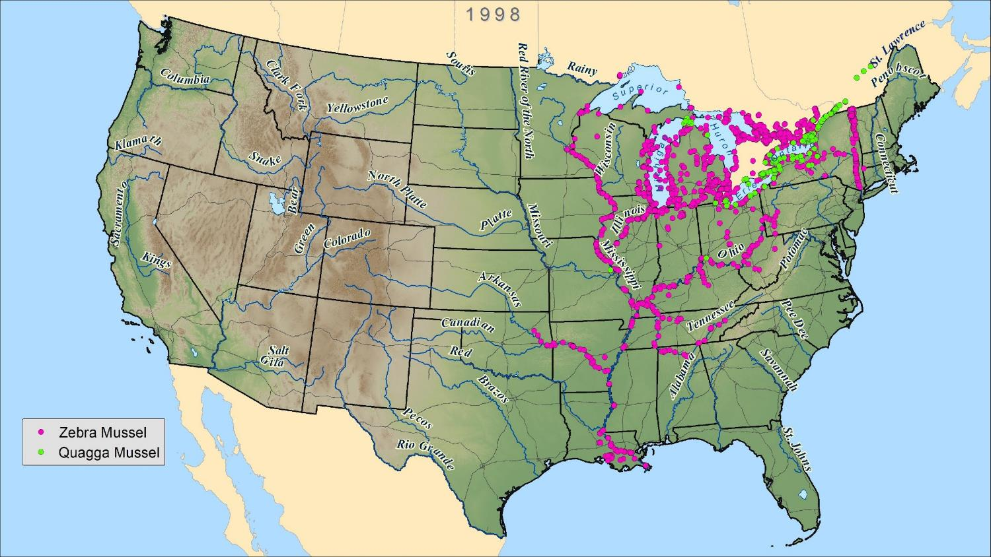
Notes:
Presenter Notes: The quagga mussels have spread to Lake Huron and Lake Michigan.

Slide 22
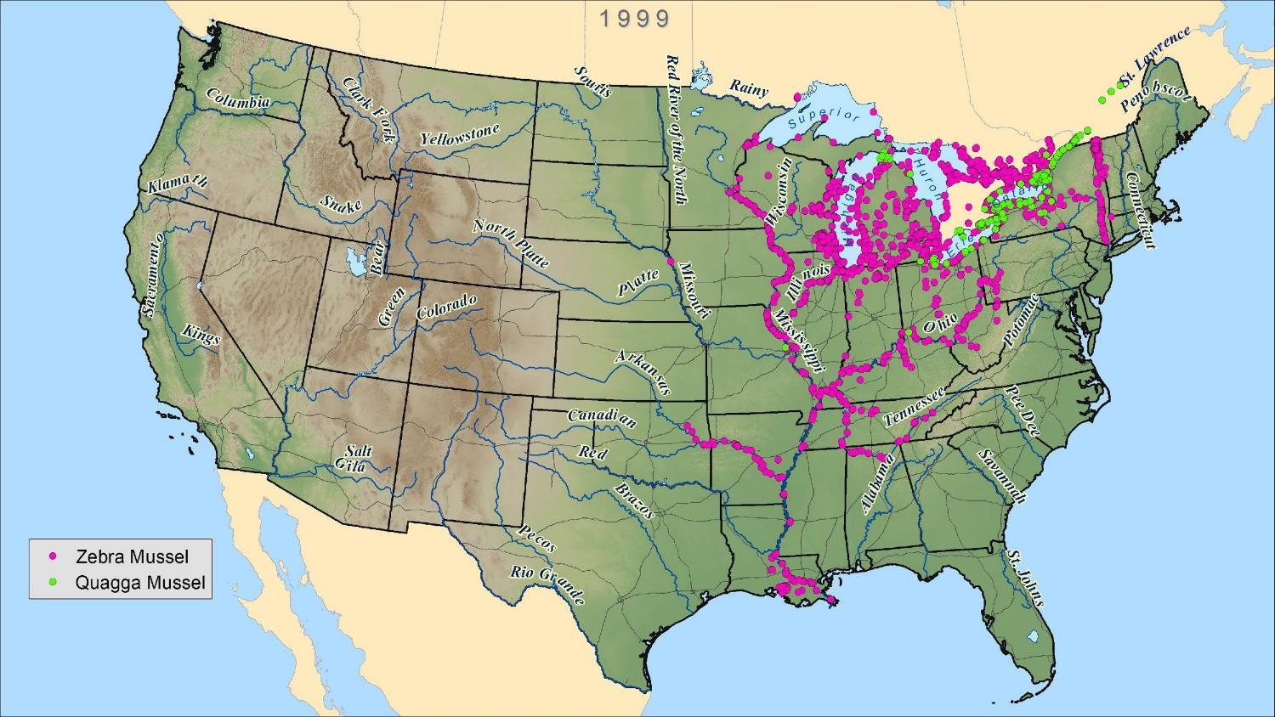
Notes:
Presenter Notes: The quagga mussels have spread to Lake Huron and Lake Michigan.

Slide 23
Notes:
Presenter Notes: The quagga mussels have spread quickly in Lake Michigan.

Slide 24
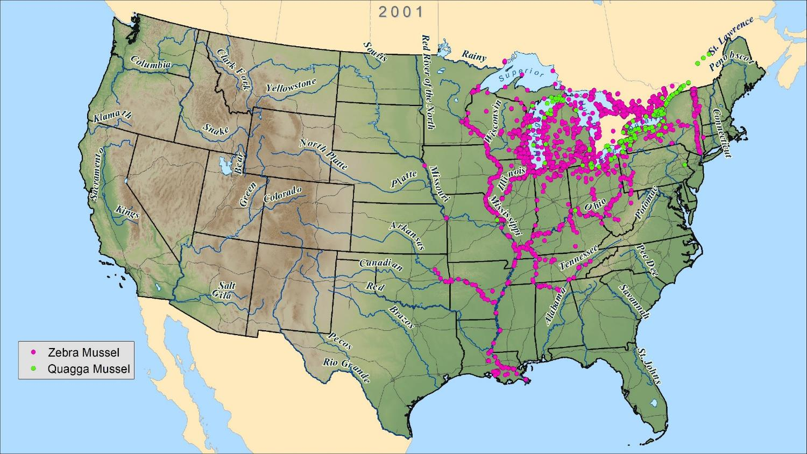
15 years later...
Notes:
Presenter Notes: Fifteen years-post introduction, the zebra mussels are now in northern sections of the Missouri River and the quagga mussels have spread into Lakes Michigan and Huron.

Slide 25
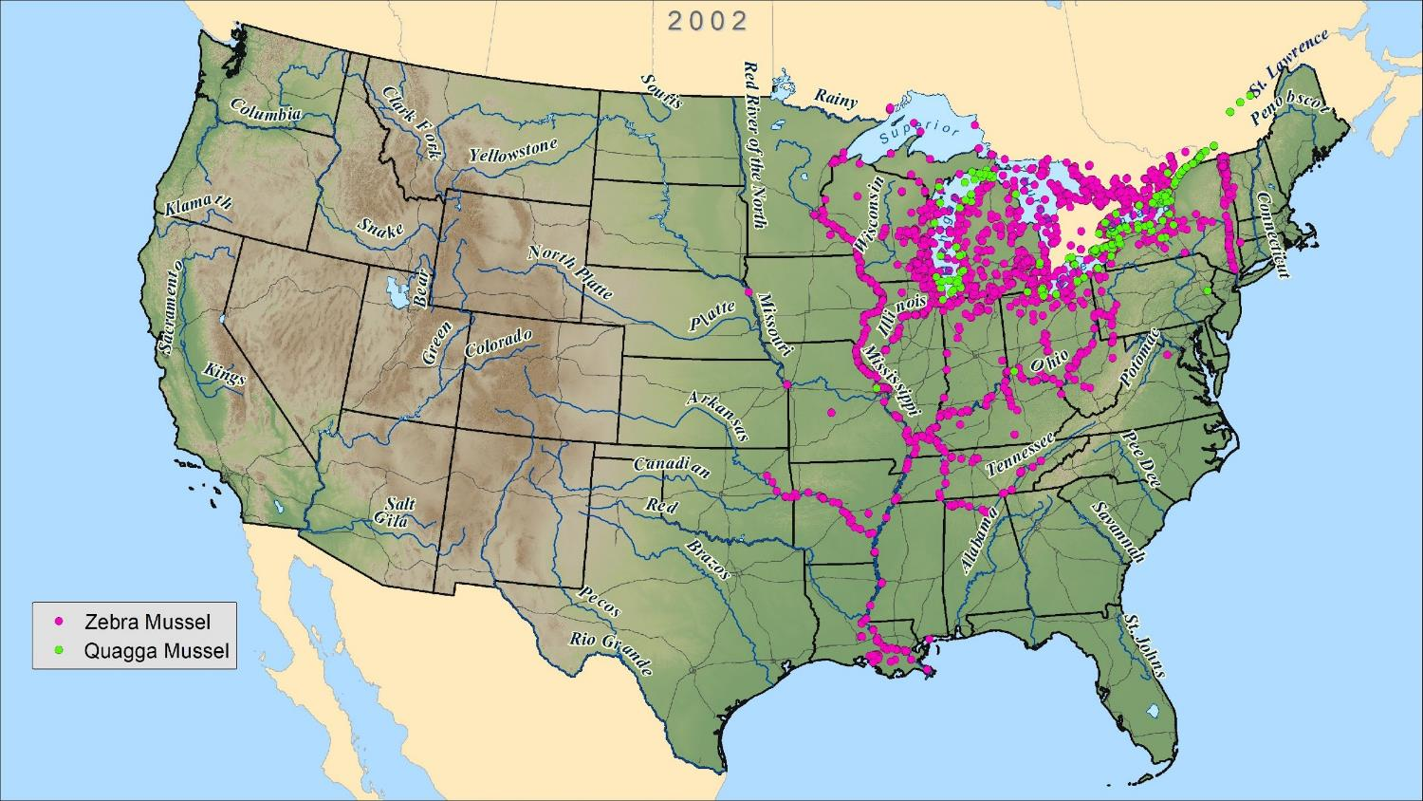
Notes:
Presenter Notes: Notice the expansion of quagga mussels in Lake Michigan. The quagga mussels have been reported to displace the zebra mussels when they are growing in the same habitat. The quagga mussels can tolerate colder temperatures and sandier substrates, and, therefore, can grow in deeper water than the zebra mussels.

Slide 26
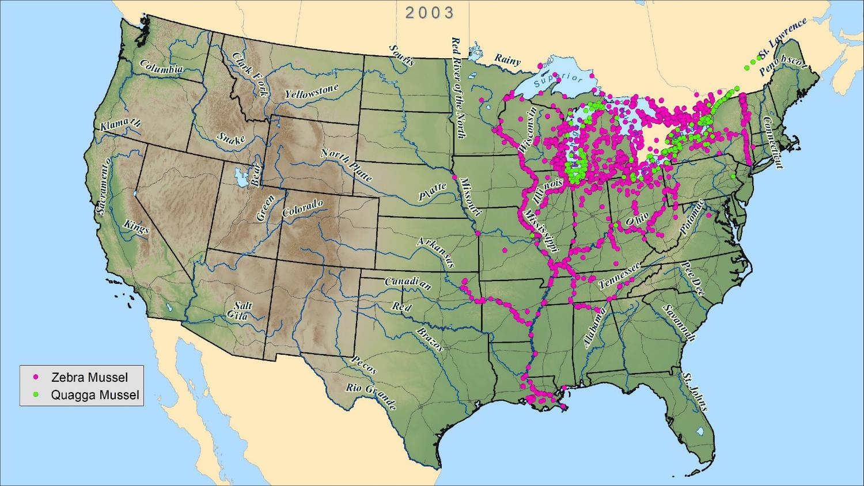
Notes:
Presenter Notes: Notice the expansion of quagga mussels in Lake Michigan. The quagga mussels have been reported to displace the zebra mussels when they are growing in the same habitat. The quagga mussels can tolerate colder temperatures and sandier substrates, and, therefore, can grow in deeper water than the zebra mussels.

Slide 27
Notes:
Presenter Notes: Notice the expansion of quagga mussels in Lake Michigan. The quagga mussels have been reported to displace the zebra mussels when they are growing in the same habitat. The quagga mussels can tolerate colder temperatures and sandier substrates, and, therefore, can grow in deeper water than the zebra mussels.

Slide 28
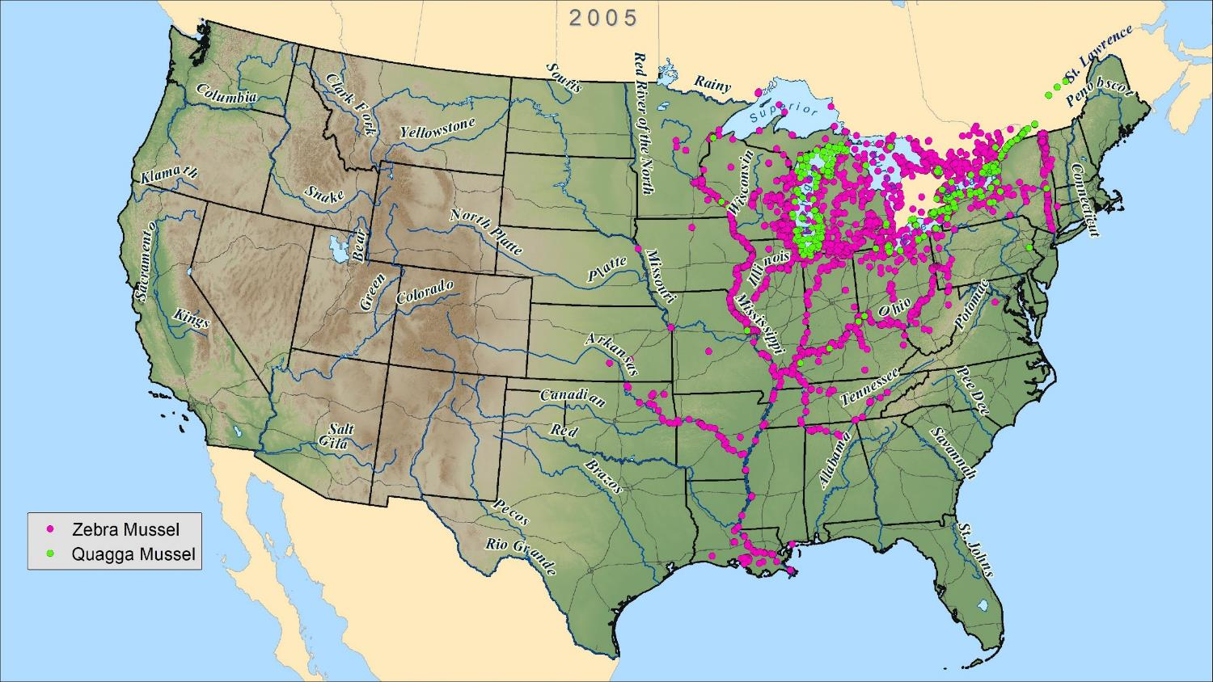
Notes:
Presenter Notes: Notice the zebra mussels have fully dispersed throughout the Mississippi River. The western U.S., Maine, and the southeast region are still clear of invasive mussels.

Slide 29
20 years later...
Notes:
Presenter Notes: Twenty years post-introduction, the zebra mussels have fully dispersed throughout the Mississippi River. The western U.S., Maine, and the southeast region are still clear of invasive mussels.

Slide 30
They crossed the continental divide!
21 years later...
30-second brainstorm... List the ways in which invasive mussels can move and spread to new areas?
Notes:
Presenter Notes: First, the students record the year the mussels crossed the continental divide. Lake Mead Recreational Area along the Colorado River was one of the first locations in the West to become infested with invasive quagga mussels. Next, the students brainstorm and record the ways in which the mussels can move and spread to new areas. Write their responses on the board as the students share their ideas. Next, circle the natural methods of dispersal (water currents, birds, etc.) and point out that most of the dispersal vectors are from human activities.

Slide 31
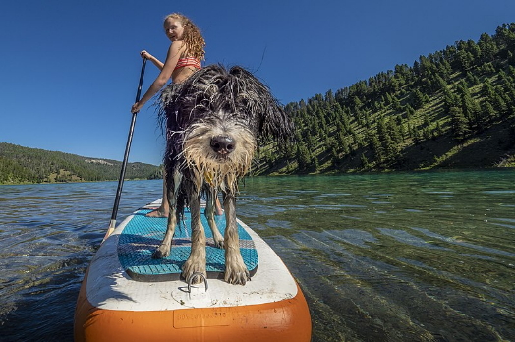
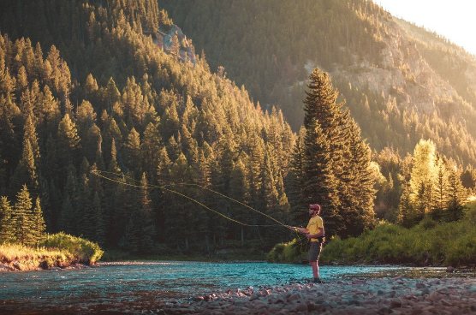
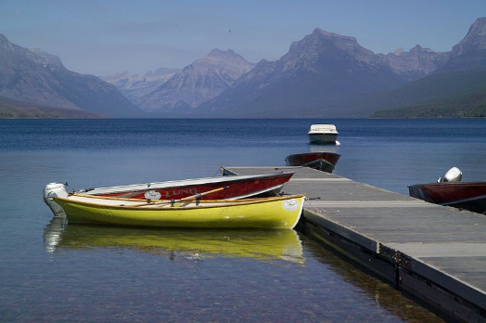
How Do Invasive Mussels Spread?
What do all of these photos have in common?
Notes:
Presenter Notes: PEOPLE are the common thread to all of these photos. We spread AIS all over the world by our recreational habits, transportation of goods, and methods of travel. Other vectors of AIS dispersal that are always good to mention are water aircraft, non-motorized vs. motorized watercraft, wading and fishing gear, boats with internal bladders, ballast water from ships, shoes, clothing, nets, and ropes.

Slide 32
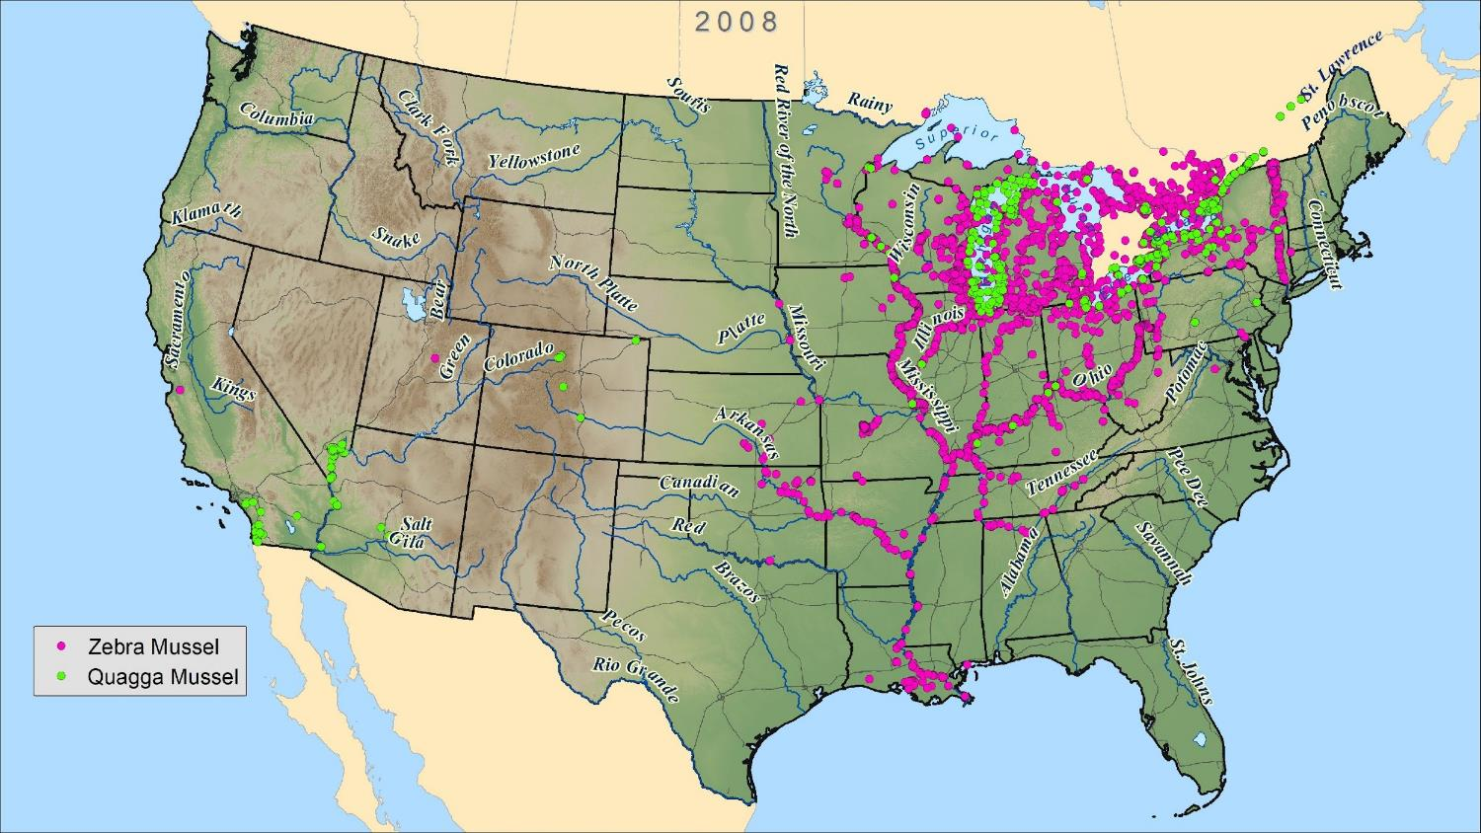
Notes:
Presenter Notes: The quagga quickly spread down the Colorado River, to Southern California, and to Colorado. Whereas, the zebra mussels spread to northern California and Utah.

Slide 33
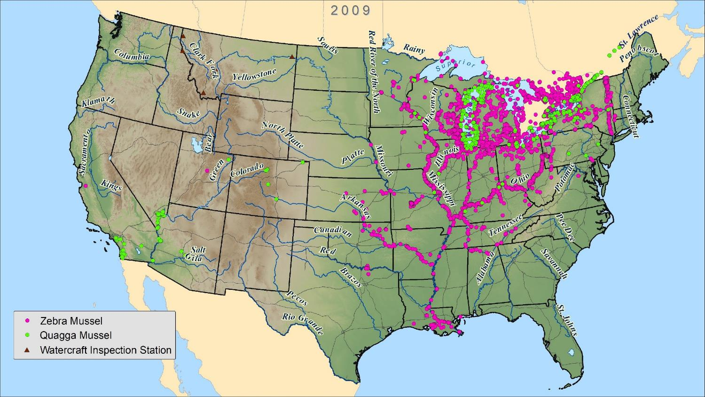
Inspection stations appear in the northwest!
Notes:
Presenter Notes: The farmers and ranchers in Idaho pushed hard for the inspection stations along the Idaho border to protect their irrigation systems. Notice, there is one inspection station along the eastern border of Montana. These inspection stations were created to inspect all of the WESTBOUND vehicles with boats.

Slide 34
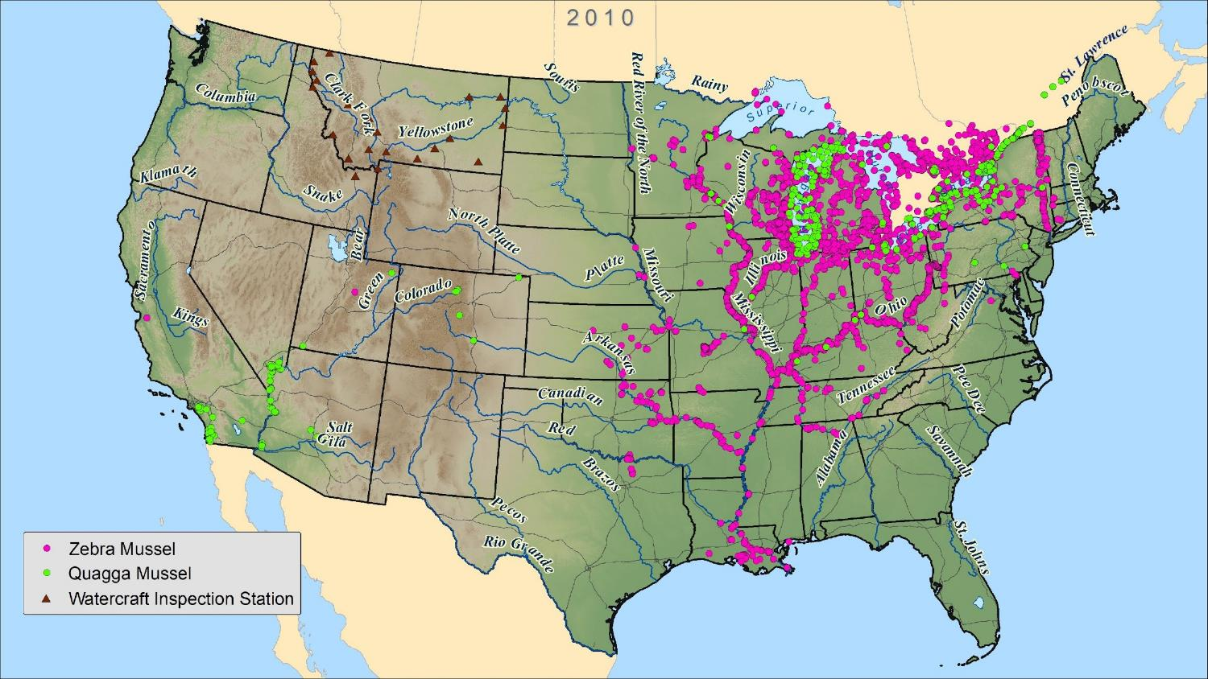
Notes:
Presenter Notes: Notice the increase in inspection stations and the slower spread of the mussels in the west.

Slide 35
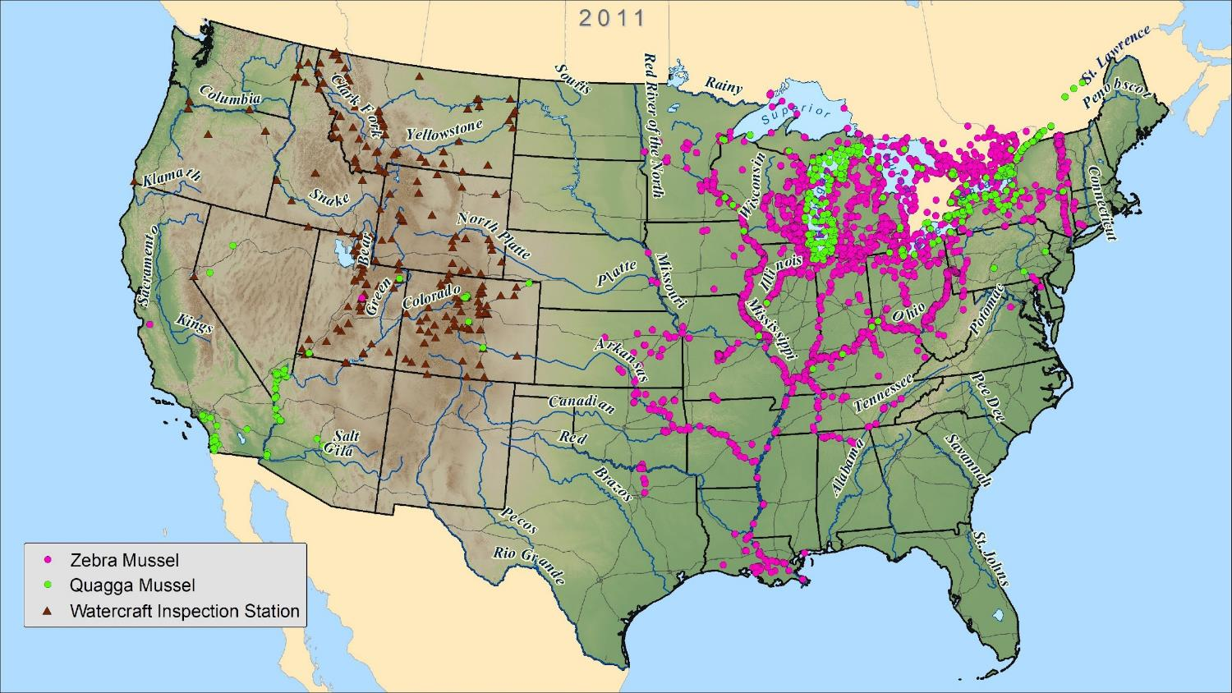
25 years later...
Notes:
Presenter Notes: Notice the increase in inspection stations and the slower spread of the mussels in the west. The quagga mussels have now made it to Nevada so an inspection station was added along the California border to protect Lake Tahoe.

Slide 36
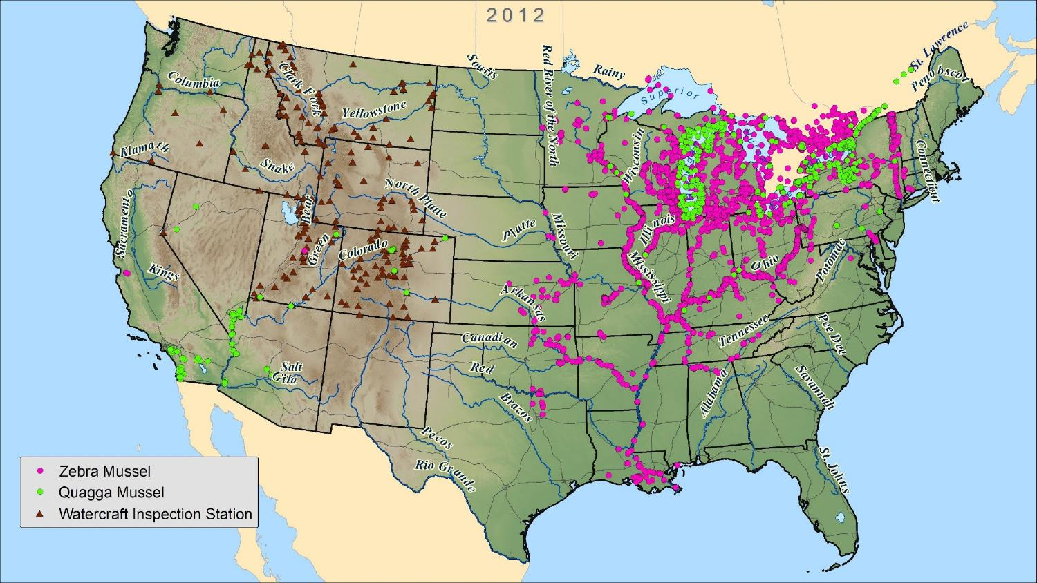
Notes:
Presenter Notes: Notice the increase in inspection stations and the slower spread of the mussels in the west.

Slide 37
Notes:
Presenter Notes: The mussels are still mostly spreading in the east at this time.

Slide 38
Notes:
Presenter Notes: Notice the increase in inspection stations and the slower spread of the mussels in the west.

Slide 39
Notes:
Presenter Notes: Notice the increase in inspection stations and the slower spread of the mussels in the west.

Slide 40
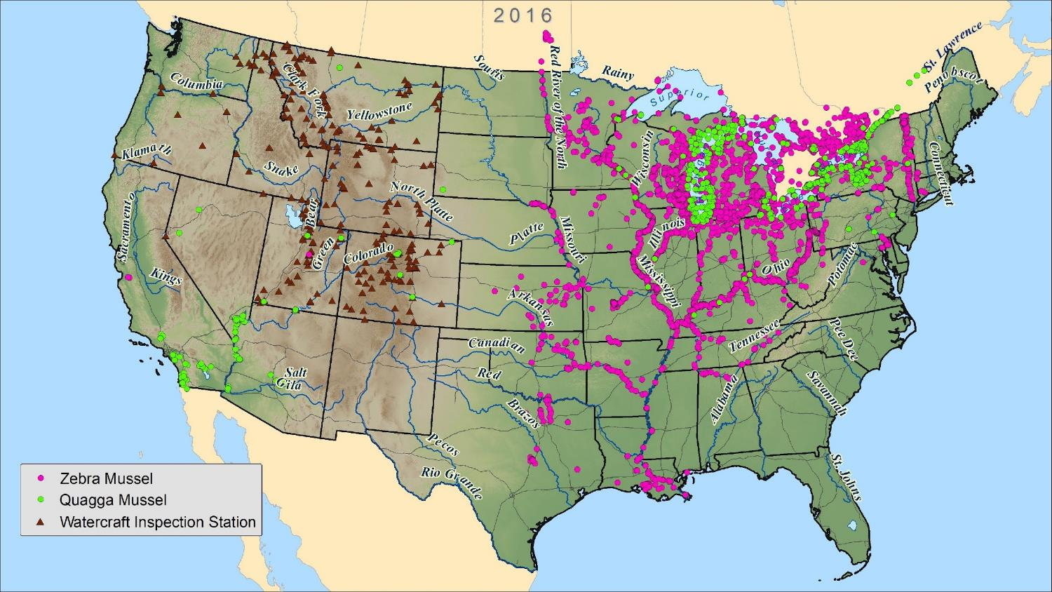
Detection in Montana
30 years later...
Notes:
Presenter Notes: Thirty years post-introduction, invasive mussels were officially detected in Tiber Reservoir. Initially, the state found mussel larvae in a sample collected at Canyon Ferry Reservoir, but they now think it was contamination from a net used in Tiber Reservoir.

Slide 41
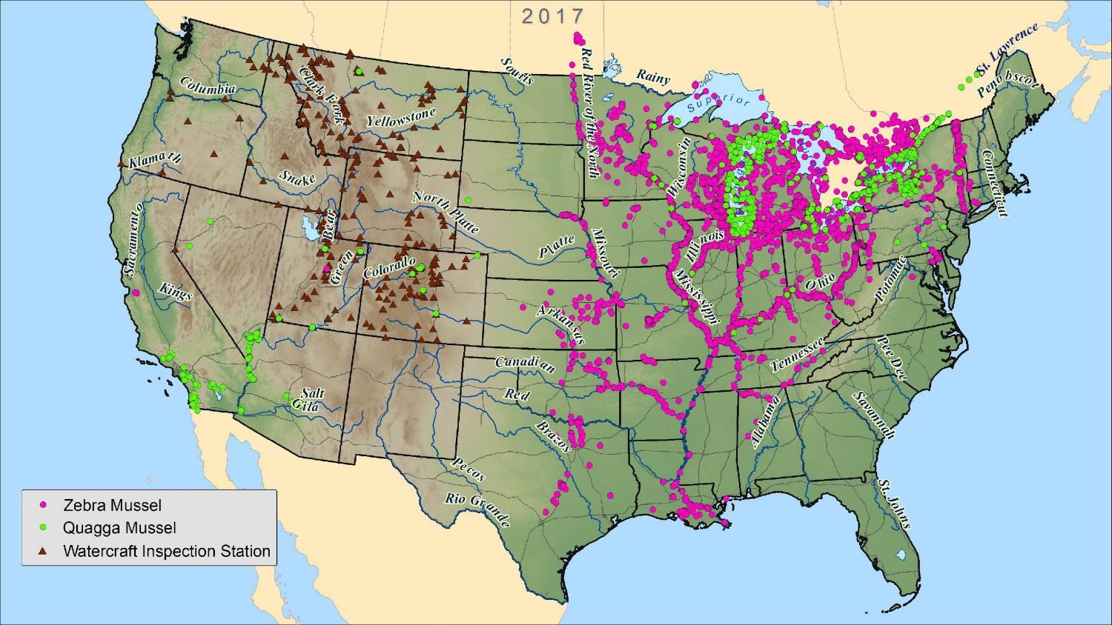
Notes:
Presenter Notes: The Pacific Northwest improved their inspection station procedures and “Clean, Drain, Dry” campaigns.

Slide 42
32 years later...
Are the inspection stations and clean, drain, dry campaigns in the northwest working?
Notes:
Presenter Notes: Ask the students to record whether the inspection stations and “Clean, Drain, Dry” campaigns are working in the northwest and what evidence supports their answer.

Slide 43
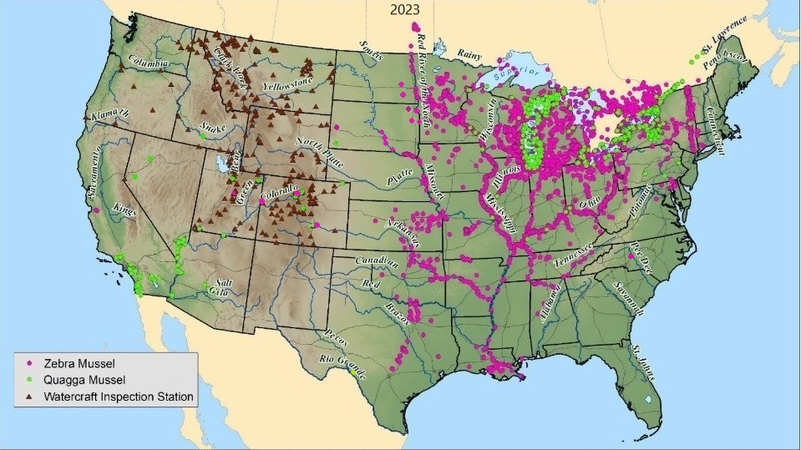
37 years later...

Slide 44
37 years later...
List the states the invasive mussels have NOT spread to.
Notes:
Presenter Notes: Students describe where the mussels have NOT spread to since their introduction. The mussels have spread to every major watershed in the country. The mussels have NOT spread to New Hampshire, Maine, Rhode Island, South Carolina, Georgia, Florida, New Mexico, Wyoming, Oregon, Washington, Hawaii, or Alaska.

Slide 45
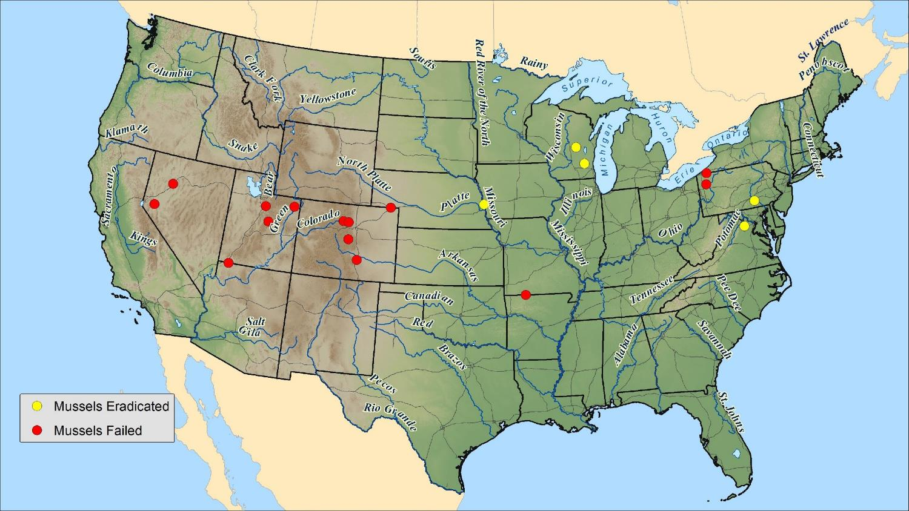
32 years later...
What are some invasion barriers
that could cause a mussel invasion to fail?
Notes:
Presenter Notes: Ask the students to describe potential invasion barriers that could cause a mussel invasion to fail. Potential answers: physical barriers (i.e. mountains, deserts), water chemistry (ex. pH, calcium, salinity), competition, predation, water temperature or only one sex arrives in a lake.

Slide 46
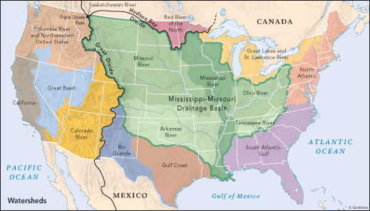
The Columbia River Basin is the last major watershed without invasive mussels!
A river basin or
watershed is an area of land drained by a river and its tributaries to a common outlet.
Notes:
Presenter Notes: Water moves across the United States by following the path of least resistance. There are 11 major river basins in the United States that direct the flow of water to the Pacific Ocean, Hudson Bay, Atlantic Ocean, and Gulf of Mexico. Rain landing on Triple Divide Peak in Glacier National Park can potentially flow into three different river basins. As a result, AIS that arrive in NW Montana could spread into these three separate basins. The Columbia River Basin is the last major river basin in the United States that does not have invasive mussels. One of the main reasons that zebra and quagga mussels have spread so easily is that their larvae are planktonic, so they can drift and be moved quickly from place to place through water currents, streams, and rivers. Once the adult zebra or quagga mussels get established in an area their larvae can be spread easily in small amounts of water.

Slide 47
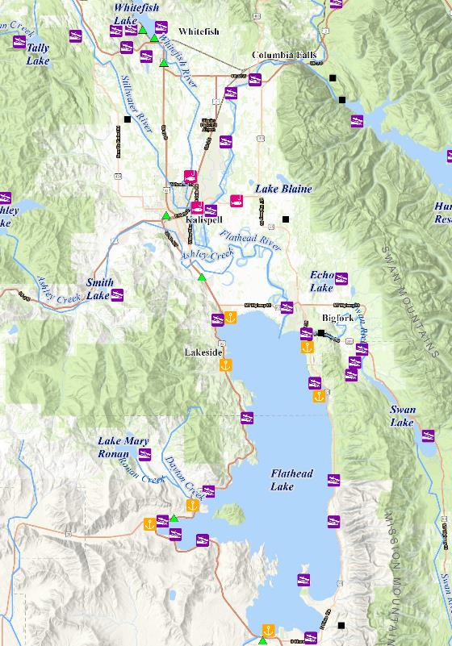
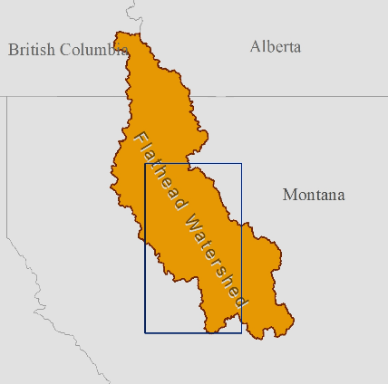
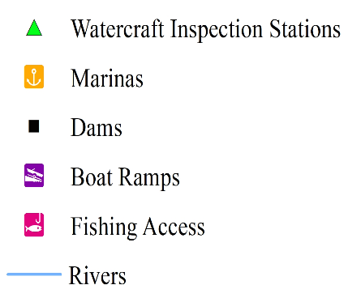
Select a
point of introduction on the Flathead Region Map
Notes:
Presenter Notes: Students work in groups or individually using the maps in the classroom. Explain to the students that the invasive mussels are NOT currently in the Flathead River Basin, but that they could potentially be introduced at anytime. Students select a point of introduction for the invasive mussels on the Flathead Lake Region Map.

Slide 48
Describe where the mussels would disperse from that location.
Notes:
Presenter Notes: Students track the path of dispersal from the point of introduction.

Slide 49
How could the aquatic environment
of the Flathead Watershed be impacted by a mussel invasion?
Notes:
Presenter Notes: Students explain how the aquatic environment could be impacted by a mussel invasion.

Slide 50
Think of a personal connection…
How could a mussel invasion impact someone you know?
Notes:
Presenter Notes: Students think of a personal connection and explain how a mussel invasion could potentially impact someone they know.

Slide 51
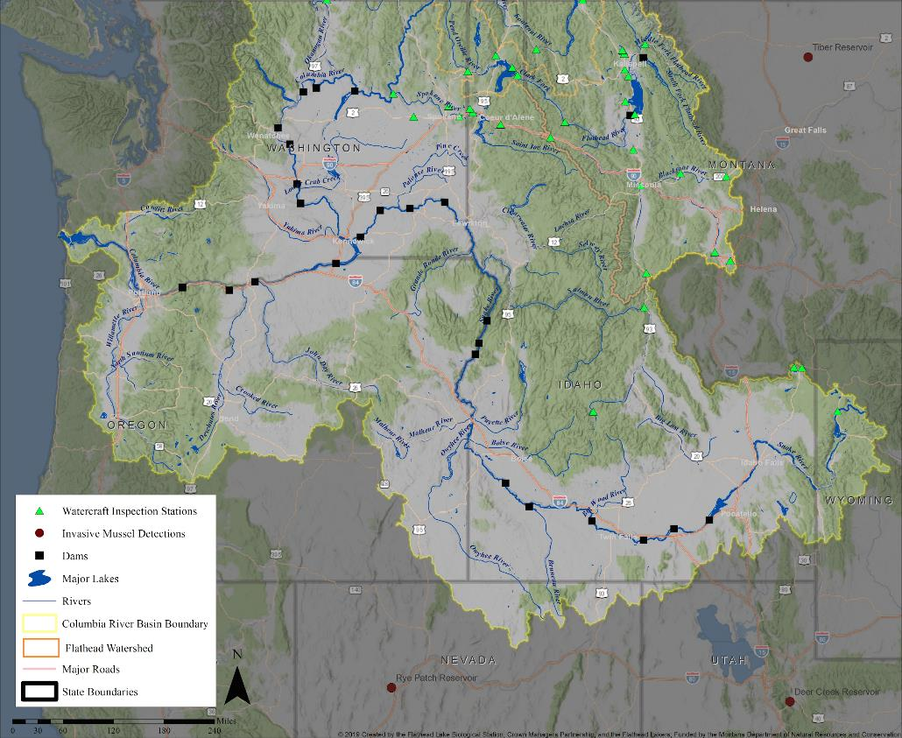
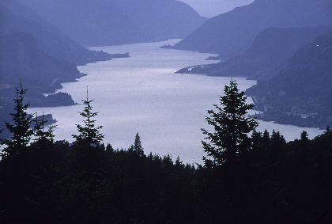
Select a topic. Use the map to explain how the Columbia River Basin economy could be impacted by a mussel invasion?
Notice the invasive mussel detections nearby...
Economy = System of how to make money
Notes:
Presenter Notes: Students select a topic from the list below and then use details from the map to explain how the Columbian River Basin economy could be impacted by a mussel invasion. Point out that there have been three mussel detections very close to the boundaries of this river basin.
Hydroelectric Dams
Farming/Irrigation
Real Estate
Restaurants
Tourism
AIS Monitoring & Prevention
Recreation (ex. fishing, rafting, swimming, sailing, boating, camping, etc.)

Slide 52
We live near the headwaters of the Columbia River Basin...
Why should we care about a potential mussel invasion?
Notes:
Presenter Notes: Students wrap up by explaining in their own words why we should care about a potential mussel invasion since we live near the headwaters of the Columbia River Basin.

Slide 53
References
Slide #1: Map of invasive species threat by Jeffrey Dukes at Purdue University
Slide #2: Photo of zebra mussels on shell by Randy Westbrooks (Bugwood.org / Public Domain)
Slides #3-4: Photo of Black and Caspian Seas by Google Earth
Photo of Volga-Don Canal by Дмитрий Николенко (public domain)
Slide #5: Photo of quagga mussels by Great Lakes Environmental Research Laboratory (CC BY-SA 2.0)
Slide #6: Photo of zebra mussels on posts by thirdwavephoto (Wikimedia Commons / CC BY 4.0)
Photo of mussels on propeller by NPS (public domain)
Diagram of zebra vs. quagga mussels by Minnesota Sea Grant (photos by John Karl)
Slide #7: Drawing of cargo ship by Holly Church at FLBS (2019)
Slide #8: Diagram of Great Lakes by On The World Maps
Slide #11: Diagrams of the ports along the Great Lakes by the Chamber of Marine Commerce

Slide 54
References
Slide #31: Photo of paddle boarder by U.S. Dept. of Agriculture (Wikimedia Commons)
Photo of water skier by Isiwal (Wikimedia Commons / CC BY-SA 4.0)
Photo of boats at Lake McDonald by David Restivo (Wikimedia Commons / CC BY-2.0)
Photo of fly fisherman by Paul Nute (Wikimedia Commons / CC0 1.0)
Slides #8-30/32-44: Mussel detection maps by Natalie Poremba/FLB
Slide #45: Photo of Columbia River by U.S. Forest Service (Wikipedia Commons)
Slides #46-49: Flathead Lake Region map by Natalie Poremba/FLBS
Slide #50: Columbia River Basin map by Natalie Poremba/FLBS
Slide #51: Photo of zebra mussels on shell by Randy Westbrooks (Bugwood.org / Public Domain)

